Slide 1






Angular Fundamentals
Course Overview,
Trainers, Evaluation
Angular
Development
SoftUni Team
Technical Trainers
Software University
http://softuni.bg

Slide 2


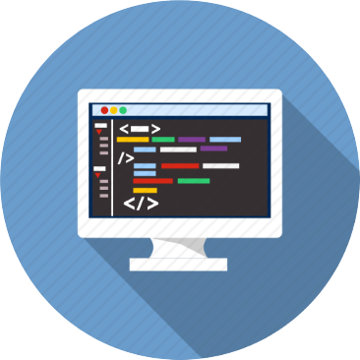
Table of Contents
Course Objectives
Course Program
Trainers Team
Course Schedule
Exams and Evaluation
Learning Resources

Slide 3
Have a Question?
sli.do #angular-js

Slide 4

Angular Fundamentals
Course Objectives & Program

Slide 5


Course Objectives
The Angular Fundamentals course provides
Basic understanding of TypeScript and Angular
Covers component-based architecture
Working with remote data using RxJS
What is NOT covered?
JavaScript basics and syntax
REST communication fundamentals

Slide 6
Warning: Not for Absolute Beginners
The "Angular Fundamentals" course is NOT for absolute beginners
Take the HTML & JavaScript courses at SoftUni first: https://softuni.bg/trainings/1271/web-fundamentals-html-css-november-2015 https://softuni.bg/trainings/1295/javascript-basics-january-2016
This course is OK for beginners, but requires previous coding skills
Requirements
HTML & JS (ES 2016) coding skills – intermediate level
Computer English – entry level

Slide 7

Course Topics
Angular overview, TypeScript syntax, advantages
Components, data binding, lifecycle
Dependency injection, services
Modules, routing, single-page applications
Forms, two-way binding, directives
Best practices, project structure

Slide 8
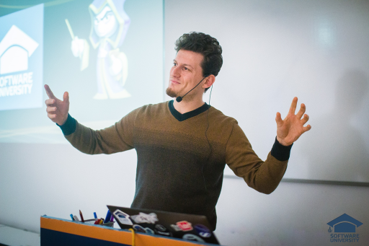
The Trainers Team

Slide 9

Trainers Team
Kiril Kirilov
Techinal Trainer @ Software University
Involved with programming since 11th grade
Recently interested in web development with JavaScript
Currently studying Math & Informatics at the University of Sofia

Slide 10
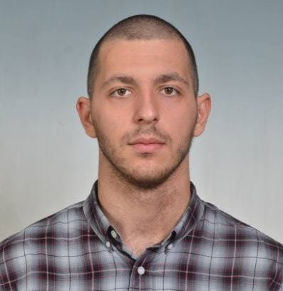
Trainers Team (1)
Hristian Hristov
Assistant Trainer @ Software University
Passionate about JavaScript
Freelance Web Developer
Finished Train the Trainers with top results

Slide 11
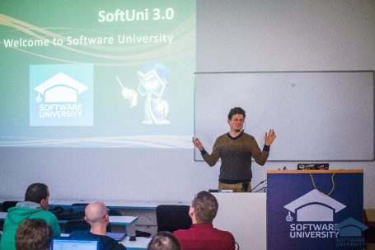


React.js Fundamentals
Course Details and Schedule

Slide 12
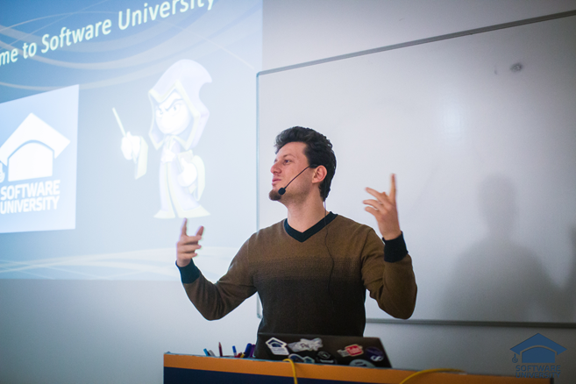
Training Duration and Schedule
Lessons: ~ 20 hours (onsite + YouTube videos)
Practical exercises (in class): ~ 40 hours
Homework: ~ 50 hours
Practical exam: 6 hours
Timeframe: Nov – Dec 2017
Project Defense: 15 Dec 2017

Slide 13


Why English?
Why are the slides in English?
English is the native language of software engineering
Specific terminology should be in English
Translations are inaccurate and funny
Just learn English!
No excuses

Slide 14


Your RFID Chip
Students can either
Take RFID chip from SoftUni
Or use their own chip / card (125 KHz)
Register your chip number in your SoftUni profile: https://softuni.bg/users/profile/show
Check-in at the reception every time when you come in SoftUni
See your last visits in your profile: https://softuni.bg/users/profile/show

Slide 15


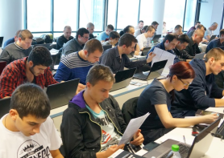
React.js Fundamentals
Evaluation Criteria

Slide 16


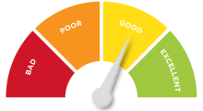
Scoring System for the Course
Final project – 90%
Exercise submissions – 10%
Presence in class – bonus up to 5%
Forum activity – bonus up to 5%

Slide 17


Homework Assignments
Your exercises are mainly work in class!
Lesson days → live workshop
Exercise days → only exercises
How to submit your homework?
Uploaded in the course Web site
Homework assignments are due in 1 week
After submission, evaluate others' work

Slide 18










Resources
What We Need Additionally?

Slide 19



Course Web Site, Forum and FB Group
Official web site:
Official discussion forum:
Official Facebook group:
softuni.bg/courses/angular-2-fundamentals
softuni.bg/forum/categories/110/Angular
fb.com/groups/Angular2November2017/

Slide 20

The Software Technologies Slides and Videos
All lecture slides, videos, homework assignments, projects and other resources are open content, available for free
Visit the course web site to access the course resources

Slide 21


Recommended Software
Node.js (Current Version)
Development Environment
Or an IDE of your choice
https://nodejs.org/en/download/
https://code.visualstudio.com/
https://jetbrains.com/webstorm/

Slide 22







Course Overview
https://softuni.bg/courses/

Slide 23





Trainings @ Software University (SoftUni)
Software University – High-Quality Education, Profession and Job for Software Developers
softuni.bg
Software University Foundation
http://softuni.foundation/
Software University @ Facebook
facebook.com/SoftwareUniversity
Software University Forums
forum.softuni.bg

